Slide 1

The Inheritance of the Believer
Old Testament Summary
Soteriology: God’s Rescue Program
Dr. Rick Griffith • Jordan Evangelical Theological Seminary
BibleStudyDownloads.org
Notes:
Today we address Part 1 of the 4-part study on The Inheritance of the Believer. This concept of inheritance (or rewards) is taught throughout the Bible—yet it is rarely taught—so I thought it good to address it.

Slide 2
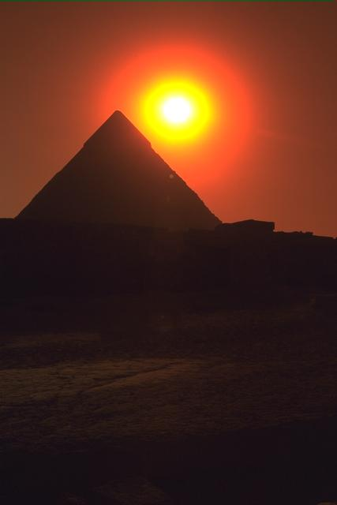
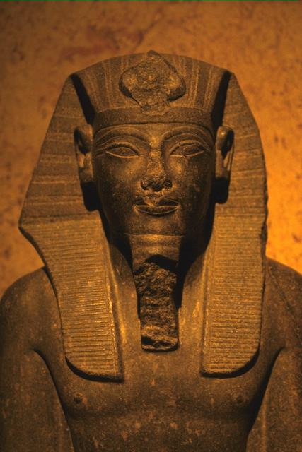
Were the Israelites of the Exodus saved from sin as well as saved from Egypt?
Give why you hold your view
Notes:
Turn to the person next to you and give your answer (YES or NO) and why.
Some say these Israelites were mostly unbelievers as we see them as idolaters in the wilderness—so they were not saved from sin.
Others say that they were saved from sin since they rejected the gods of Egypt—but they were not rewarded.

Slide 3

How can we balance the Bible’s teaching on salvation and rewards?
• 3 ways
This Photo by Unknown Author is licensed under CC BY
Notes:
Were these Israelites saved? Our answer to this question will impact how we look at many OT and NT texts.
Was Canaan for them representative of entering heaven? There are huge theological implications of this question, so we will take four weeks to explore such issues.
Preview: Let’s balance the Bible’s teaching on salvation and rewards today with three observations.

Slide 4
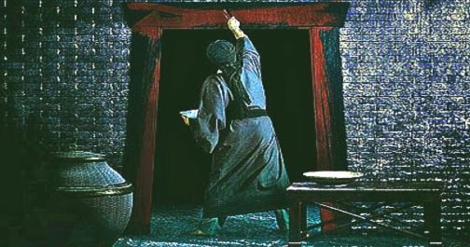
1. God saved Israel from Egypt and from sin by simple faith.
Notes:
[The Exodus generation was saved by faith shown in killing a Passover lamb.]
_______
This Photo by Unknown Author is licensed under CC BY-NC-ND

Slide 5
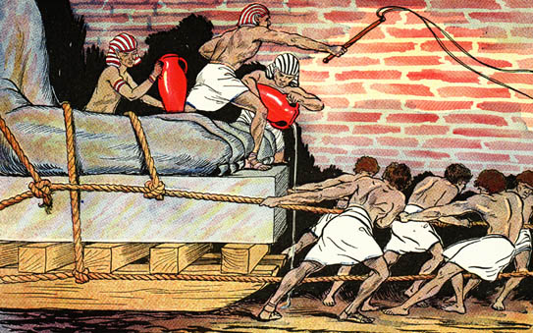
Egyptians Ruthlessly Oppressed Israel
Notes:
Egyptians ruthlessly oppressed Israel which God used to motivate them to leave Egypt.

Slide 6
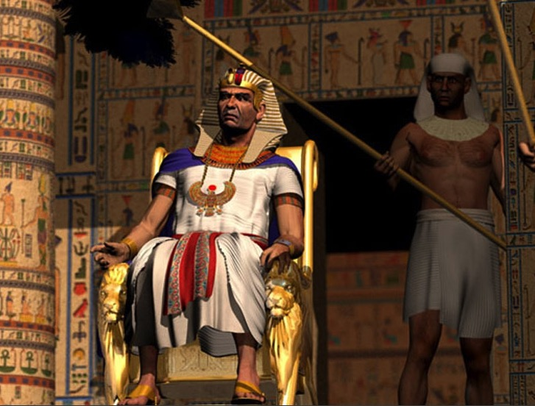
"Ultimate" Power
Notes:
But Pharaoh claimed to have ultimate power.

Slide 7
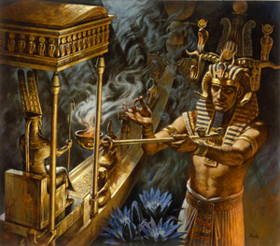
Who has greater power – Pharaoh or Yahweh?
Notes:
The question was whether Pharaoh or Yahweh was more powerful.

Slide 8
God used Moses to urge Pharaoh to free Israel from slavery to show that:
The Point of Exodus 1–11
• the LORD cared,
• was faithful to the Abrahamic Covenant, and
• was sovereign over Egypt’s gods.
Notes:
Exodus 1–11 teaches God’s faithful care and sovereignty.
____________
BE-02-Exodus-52
OS-02-Exodus-70
SA-15-Inheritance-6
TP-01-Our Inheritance OT Summary-8

Slide 9

Traditional Route of the Exodus
Canaan
107
Goshen
Nile River
Mt. Sinai
Egypt
Midian
Notes:
(But how did God defeat the superpower of the day and bring Israel out of Egypt?)
______
Common-184
OS-02-Exodus-35
TP-01-Our Inheritance OT Summary-9

Slide 10

Passover Protection
"The blood will be a sign for you on the houses where you are; and when I see the blood, I will pass over you. No destructive plague will touch you when I strike Egypt."
Exodus 12:13 (NIV)
Notes:
God commanded blood on the doorposts (Exodus 12:13). Then the death angel saw the blood on the top of the door and the two sides.
____________
Common-186
NB-14 Religion 5 Passover & Lord's Supper-107
NS-07-1Cor11
TP-01-Our Inheritance OT Summary-10

Slide 11
Faith Pictured
"By faith he kept the Passover and the sprinkling of blood, so that the destroyer of the firstborn would not touch the firstborn of Israel."
Hebrews 11:28 (NIV)
Notes:
The author of the Book of Hebrews rightly observed that doing such a "silly" act would have taken great faith that it would save lives.
____________
Common-187
NB-14 Religion 5 Passover & Lord's Supper-107
NS-07-1Cor11
NS-19-Hebrews
TP-01-Our Inheritance OT Summary-11

Slide 12
The Lamb Pictured
"The next day John saw Jesus coming toward him and said, 'Look, the Lamb of God, who takes away the sin of the world!'"
John 1:29 (NIV)
Notes:
The lamb depicted the real Passover Lamb (John 1:29).
John the Baptist drew the parallel between the Passover blood and the Lord Jesus, perhaps even implying that the places where the blood was put on the door would correspond to the places where Jesus would be pierced as our Passover Lamb.
(So, what is the typology here?)
____________
Common-188
NB-14 Religion 5 Passover & Lord's Supper-107
NS-07-1Cor11
NS-19-Hebrews
TP-01-Our Inheritance OT Summary-12

Slide 13

2. Jesus is our New Exodus who delivers us from sin as our Passover Lamb.
Notes:
[Christ saves from sin’s slavery like the Passover lamb saved Israel from Egypt’s slavery.]

Slide 14



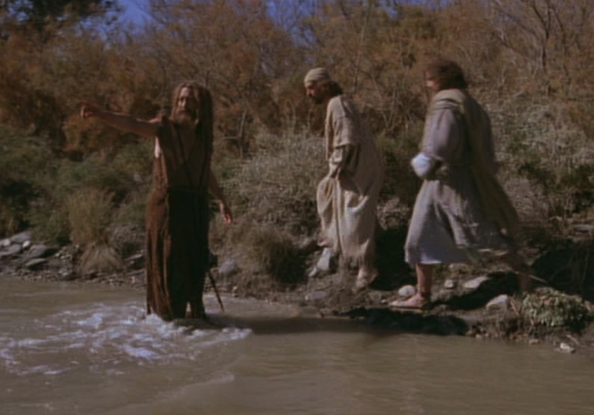
The Passover Lamb
"Look, the Lamb of God,
who takes away
the sin of the world!"
(John 1:29)
Notes:
John told his disciples that Jesus would atone for sin as the Passover lamb atoned for Israel’s sin.

Slide 15
The Cross Pictured
"For Christ, our Passover lamb, has been sacrificed."
1 Corinthians 5:7 (NIV)
Notes:
Paul taught that Jesus is our Passover Lamb like the bloody cross on the door (1 Cor 5:7).

Slide 16

Faith in a Lamb
Notes:
Israel’s faith in their lamb ultimately pointed to their faith in the Lamb.
Israel trusted that the blood of the lamb would take away their own sin as they placed their faith in God instead of Egypt's gods.
____________
Common-190
NB-14 Religion 5 Passover & Lord's Supper-106?
NS-07-1Cor11?
TP-01-Our Inheritance OT Summary-16

Slide 17

"This is my body…"
Notes:
Jesus changed the wording of the typical Passover meal ("This is the bread of affliction") by identifying the Passover lamb as ultimately depicting his own body shed to redeem people from slavery. “This is my body” meant that Jesus’s death paid for our sins.
____________
Common-191
NB-14 Religion 5 Passover & Lord's Supper-107
NS-07-1Cor11
TP-01-Our Inheritance OT Summary-17

Slide 18
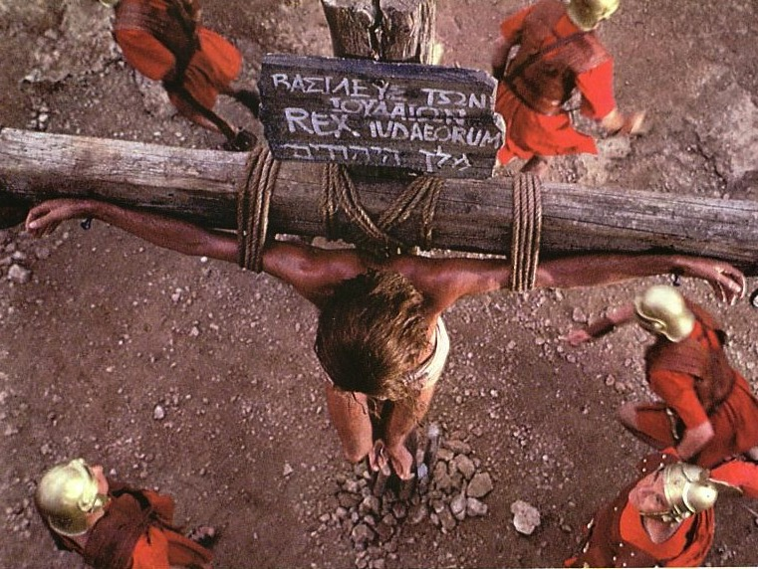
Jesus' death paid for our sin
Notes:
The death of Jesus was more than simply a model of self-sacrifice or humility, as some have claimed. It was the payment of the debt we owe to God—the debt of our very lives.
_____________
Common-192
NS-06-Rom3-4-slide 61
TP-01-Our Inheritance OT Summary-18

Slide 19

Exodus 12:1-16
The Angel of Death Passed Over Houses with Blood on the Doors
Thus says the LORD, "About midnight I will go out in the midst of Egypt" (Exod. 11:4)
Notes:
As the Passover Angel passed over the blood-stained doors of the Israelites in slavery, God likewise passes over our many sins by seeing instead the blood of Christ shed on our behalf.
_____________
Common-193
NS-06-Rom3-4-slide 61
TP-01-Our Inheritance OT Summary-19

Slide 20
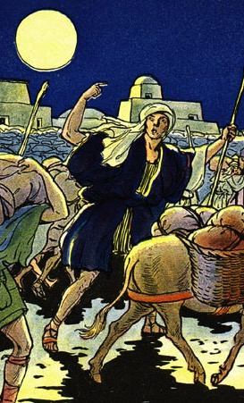
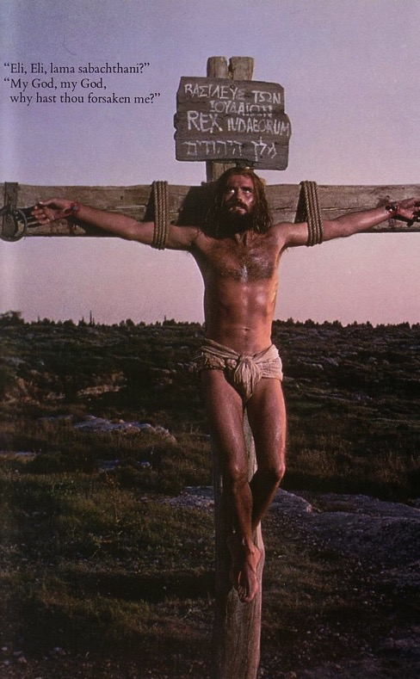
The Common Thread
What the Exodus is to the Old Testament…
the cross of Christ is to the New Testament
DELIVERANCE!
Notes:
Both lambs delivered people from slavery yet of different kinds. Ours is even more severe since we are not temporary political or economic slaves but lifetime slaves of sin.
_______________
Common-194
BE-02-Exodus-87
NB-14 Religion 5 Passover & Lord's Supper-107
NS-07-1Cor11
TP-01-Our Inheritance OT Summary-20

Slide 21
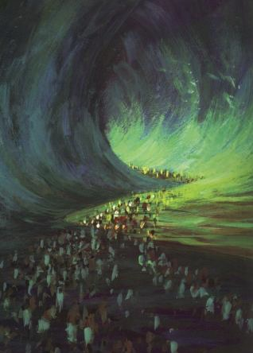
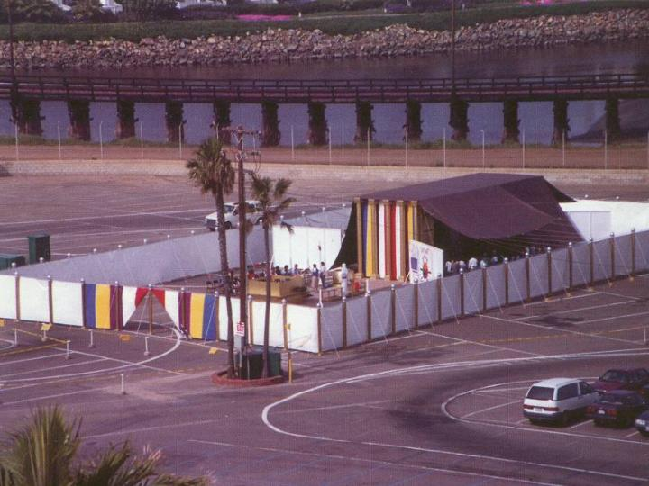
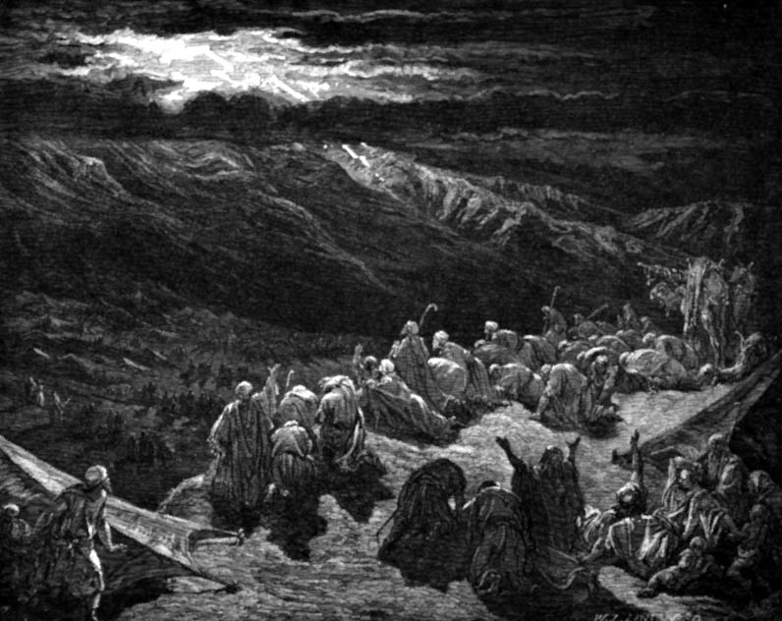
The Exodus Pictures Redemption
"For he has rescued us from the dominion of darkness and brought us into the kingdom of the Son he loves, in whom we have redemption, the forgiveness of sins."
Colossians 1:13-14 (NIV)
Notes:
The Exodus pictures redemption in that all in the Exodus were saved.

Slide 22

1 Corinthians 10:1-5 (NLT)
"I don't want you to forget, dear brothers and sisters, about our ancestors in the wilderness long ago. All of them were guided by a cloud that moved ahead of them, and all of them walked through the sea on dry ground. ²In the cloud and in the sea, all of them were baptized as followers of Moses. ³All of them ate the same spiritual food, ⁴and all of them drank the same spiritual water. For they drank from the spiritual rock that traveled with them, and that rock was Christ. ⁵ Yet God was not pleased with most of them, and their bodies were scattered in the wilderness."
Notes:
All delivered from Egypt were believers, but most were judged (1 Cor 10:1-5).

Slide 23
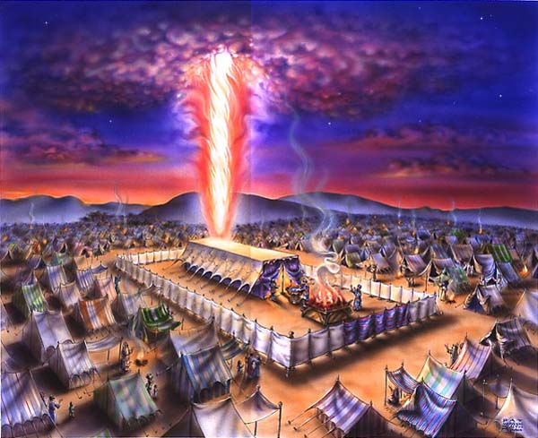
The Cloud
Exodus 40;
1 Cor. 10:1-4
Notes:
“All of them were guided by a cloud that moved ahead of them”

Slide 24


The Sea
Exodus 40;
1 Cor. 10:1-4
Notes:
“All of them walked through the sea on dry ground.”

Slide 25

The Leader
Exodus 40;
1 Cor. 10:1-4
Notes:
“All of them were baptized as followers of Moses.”

Slide 26
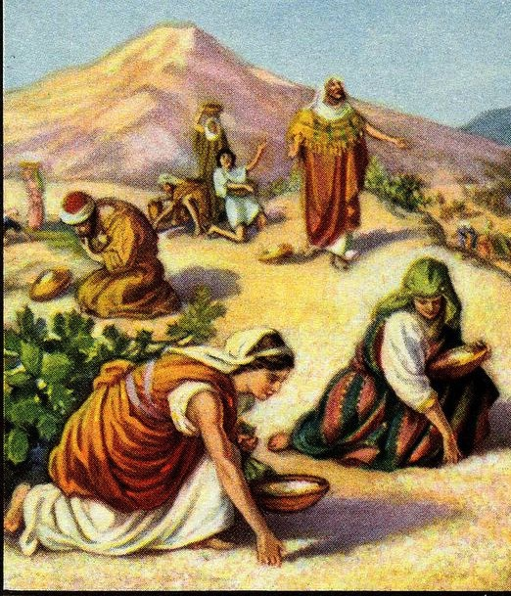
The Food
Exodus 40;
1 Cor. 10:1-4
Notes:
“All of them ate the same spiritual food.”

Slide 27
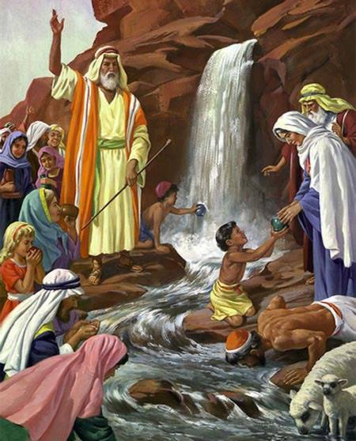
The Water
Exodus 40;
1 Cor. 10:1-4
Notes:
“All of them drank the same spiritual water. For they drank from the spiritual rock that traveled with them, and that rock was Christ.”

Slide 28

Which is the Most Accurate?
121a
Salvation by…
Faith + Works
Faith Alone
Faith + Works
OT
Works
Faith Alone
Faith Alone
Faith + Works
NT
Faith
• Which verses in the Bible support your answer?
cf. OTS 119e
Notes:
Did God change the means of salvation from the OT to the NT?
We are NOT talking about whether people should do good works—we all agree on that. But are works needed for salvation?
Paul answers this question in Romans 4 with the example of Abraham who was saved by faith alone—see Gen 15:6.
________
Common-195
BE-03-Lev-27
OB-37-Sacrifices-72_eng_ob_1667_v5—slide 17
OB-39-Salvation-2
OS-03-Leviticus-13
OP-03-Lev-27
OP-Lev_6v24-7v10 Why All That Blood Sin & Guilt Offerings-49_eng_op_v4.0—slide 34
OS-04-Num-27
NP-Acts_15v1-35_Dont_Be_Law_Abiding_(Rick_Griffith)-61_eng_pr_v4—slide 5
NS-05-Acts15-16-slide 26
NS-Rom3-4-slide 77
NS-09-Galatians-48
NS-20-James-30
NS-23-1Jn-58
SA-03-Biblical Terms-6
SA-15-Inheritance-26
TP-01-Our Inheritance OT Summary-28

Slide 29
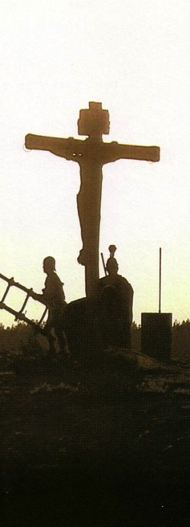
Salvation in All Ages:
The Centrality of the Cross
B.C.
Looked forward to the
Cross of Christ
A.D.
Look
back at the
Cross of Christ
Notes:
We must see the centrality of the cross—how people before Jesus believed by looking toward the cross while those of us after Jesus look back at the cross. In other words…
The grounds of salvation has always been the death of Christ—for believers before and after the cross.
____________________
Common-198
BE-03-Leviticus-73
OB-37-Sacrifices-19
OB-38-Salvation-4
OS-03-Leviticus-193
NS-09-Galatians-16, 50
NS-20-James-32
SA-03-Biblical Terminology-10
SA-15-Inheritance-26
TP-01-Our Inheritance OT Summary-29

Slide 30
Salvation & Sanctification
121a
Man's Role
God's Response
Life of Faith
Restored Fellowship
Faith in God as offered Passover Lamb
Journey to Canaan
Sacrifices
(Sin, Guilt)
OT
Exodus
Type
|
Antitype
Type
|
Antitype
Type
|
Antitype
Type
|
Antitype
Faith in Christ as Lamb of God (1 Cor. 5:7)
Salvation
(1 Cor. 10:1-4)
Growth
(1 Cor. 10:5)
Confession
(1 John 1:9)
NT
Positional Sanctification
Progressive Sanctification
Notes:
The OT plan of salvation is mirrored in the NT—both by simple faith in the Lamb pictured in the Passover.
Exodus from Egypt is a type of the believer who leaves his slavery to sin—all believers in the Lamb are saved, including all Israelites who left Egypt as they demonstrated that faith by putting the blood on the doorposts of their homes (=positional sanctification).
But both OT and NT believers must live a life of faith in God, pictured in Israel’s journey to Canaan and mirrored in the Christian’s growth or progressive sanctification.
Finally, as OT believers confessed their ongoing sins in the sin and guilt sacrifices (for restoring fellowship with God—NOT for salvation!), so NT believers confess sins even after they are saved to restore their fellowship (NOT relationship!) with God.
_________
Common-199
OB-37-Sacrifices-18
OS-00-Book Overviews-73
OS-03-Leviticus-70
OS-04-Numbers-13, 207
NS-09-Galatians-49
NS-20-James-31
SA-03-Biblical Terms-7
SA-15-Inheritance-26
TP-01-Our Inheritance OT Summary-30

Slide 31

OT Forgiveness of Sin
121b
Pipe = Relationship with God (never changing)
Sin
Clog = Fellowship with God (hindered by sin)
Sacrifices = Confession of Sin (sin forgiven to restore fellowship but relationship was never threatened)
Notes:
Israel's relationship with God can be compared to a pipe.
Occasionally the pipe got a clog—like sin—that hindered their fellowship with God.
Did Israelites still have a relationship with God when they sinned? Yes!
Sin did not hinder their relationship with God but their fellowship with Him.
OT sacrifices did not establish a relationship with God but rather they restored their fellowship with God.
________
Common-207
OS-03-Leviticus-14
OS-04-Num-29
OP-02-Lev-28
NS-23-1Jn-79
SA-03-Biblical Terms-9
SA-15-Inheritance-27
TP-01-Our Inheritance OT Summary-31

Slide 32
NT Forgiveness of Sin
121b
"If we confess our sins,
He is faithful and righteous to forgive us our sins and to cleanse us from all unrighteousness"
(1 John 1:9 NAU)
Pipe = Relationship with God (never changing)
Sin
Clog = Fellowship with God (hindered by sin)
Christ's Sacrifice = The Basis for Confession of Sin (sin is forgiven to restore fellowship but relationship has never been never threatened)
Notes:
Our relationship with God can be compared to a pipe.
Occasionally the pipe gets a clog—like sin—that hinders our fellowship with God.
Do we still have a relationship with God when we sin? Yes!
Sin does not hinder our relationship with God but our fellowship with Him.
_________
Common-208
OB-38-Salvation-11
OS-03-Leviticus-56, 72, 130
OS-04-Numbers-30
NS-23-1Jn-80
SA-03-Biblical Terms-9
SA-15-Inheritance-28
TP-01-Our Inheritance OT Summary-32

Slide 33
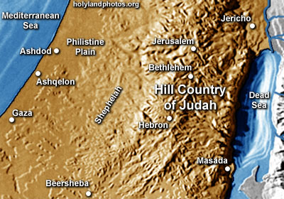
Inheritance in the OT
But if the Israelites of the Exodus were saved, why didn’t they enter Canaan?
Notes:
(So, if the Israelites of the Exodus were saved, why didn’t they enter Canaan?)
________
Common-258
OP-04-Numbers-87
OS-04-Numbers-135
OS-06-Joshua-177
NS-19-Hebrews-59, 187
TP-01-Our Inheritance OT Summary-33

Slide 34

3. Inheritance in the OT included both salvation and reward.
Notes:
[The OT teaches two inheritances—one by faith and one by works.]

Slide 35


The Future Reign of the Servant Kings
Jody Dillow is the key author of the Partakers View
Final Destiny
The Future Reign of the Servant Kings
Joseph Dillow
Notes:
• There is a future reign of the Servant Kings—that is you and me!
• Our future inheritance is well articulated by Joseph Dillow in his massive book, Final Destiny
• Dillow is the key author of what he calls the Partakers View.
This view explains inheritance in the OT.
Inheritance in the OT was of two types:
All Israelites who believed in the LORD would have God as their inheritance—or be saved.
But only those Israelites that obeyed the LORD wholeheartedly would inherit Canaan—or be rewarded.
___________
Common-257
OS-04-Numbers-148
OS-06-Joshua-175
NS-19-Hebrews-58, 186, 448
SA-15-Inheritance-35, 173
TP-01-Our Inheritance OT Summary-35

Slide 36
Inheritance in the OT
1. A difference exists between inheriting the land of Canaan and living there. The former refers to ownership and the latter to mere residence.
2. While Israel was promised the inheritance as a nation, the condition for maintaining their inheritance right to the land of Canaan was faith, obedience, and completion of one's task. The promise, while national, was applied only to the believing and obedient remnant.
Joseph Dillow, Final Destiny, 56
Notes:
Dillow sums up the OT inheritance in six truths…
These first two show that inheritance was conditioned on obedience. That is why only two men out of the more than 600,000 fighting men who left Egypt made it into Canaan. Even Moses, Aaron, and Miriam did not enter the land, so the inheritance obviously does not signify heaven!
________
Common-259
OP-04-Numbers-88
OS-04-Numbers-147
OS-06-Joshua-175
NS-19-Hebrews-60, 188
TP-01-Our Inheritance OT Summary-36

Slide 37
Inheritance in the OT
3. The inheritance is not to be equated with heaven but with something in addition to heaven, promised to those believers who faithfully obey the Lord.
4. Just as Old Testament believers forfeited their earthly inheritance through disobedience, we can also forfeit our future reward (inheritance) by a similar failure. Loss of inheritance, however, does not mean loss of salvation.
Joseph Dillow, Final Destiny, 56
Notes:
Inheritance is the earthly reward for perseverance.
________
Common-260
OP-04-Numbers-89
OS-04-Numbers-137
OS-06-Joshua-176
NS-19-Hebrews-61, 189
TP-01-Our Inheritance OT Summary-37

Slide 38
Inheritance in the OT
5. Two kinds of inheritance were enjoyed in the Old Testament. All Israelites who had believed and were therefore regenerate had God as their inheritance but not all inherited the land. This paves the way for the concept that the New Testament may also teach two inheritances. We are all heirs of God, but we are not all joint-heirs with Christ, unless we persevere to the end of life. The former refers to our salvation and the latter to our reward.
Joseph Dillow, Final Destiny, 56
Notes:
All Israelites and the rabble (Egyptians who believed) who came out of Egypt placed the lamb's blood on their doors, signifying their trust in the LORD instead of the Egyptian gods. Thus they had the inheritance of salvation. Yet the great majority did not continue to believe in God to bring them into Canaan, as this was an inheritance only for those who persevered. Likewise, the NT has two types of inheritance: salvation for those who believe and reward for the saved who persevere.
________
Common-261
OP-04-Numbers-90
OS-04-Numbers-138
OS-06-Joshua-177
NS-19-Hebrews-62, 190
TP-01-Our Inheritance OT Summary-38

Slide 39
Inheritance in the OT
6. A child of Israel was both an heir of God and an heir of Canaan by virtue of faith in God resulting in regeneration. Yet only those believers in Israel who were faithful would maintain their status as firstborn sons who would actually receive what had been promised to them as an inheritance.
Joseph Dillow, Final Destiny, 56
Notes:
The firstborn sons in the OT by right were promised the double portion of their father's estate. Yet this was conditioned on faithfulness. Reuben was Jacob's firstborn, but his unfaithfulness caused the rights of the firstborn to pass to Joseph, whose two sons each received an inheritance (1 Chronicles 5:1-2). Yet this did not relate to the salvation of Reuben, who was saved by faith. It only spoke of his reward. Likewise, NT inheritance for the believer is conditioned on continued obedience.
________
Common-262
OP-04-Numbers-92
OS-04-Numbers-139
OS-06-Joshua-178
NS-19-Hebrews-63, 191
TP-01-Our Inheritance OT Summary-39

Slide 40

Salvation is by faith but rewards are by works.
Main Idea
Notes:
We come into a right relationship with God by placing our trust in Christ—but that is just the beginning as we need to obey him to be fully blessed (MI restated).

Slide 41
1. God saved Israel from Egypt and from sin by simple faith.
Notes:
[The Exodus generation was saved by faith shown in killing a Passover lamb.]
_______
This Photo by Unknown Author is licensed under CC BY-NC-ND

Slide 42
2. Jesus is our New Exodus who delivers us from sin as our Passover Lamb.
Notes:
[Christ saves from sin’s slavery like the Passover lamb saved Israel from Egypt’s slavery.]

Slide 43
3. Inheritance in the OT included both salvation and reward.
Notes:
[The OT teaches two inheritances—one by faith and one by works.]

Slide 44
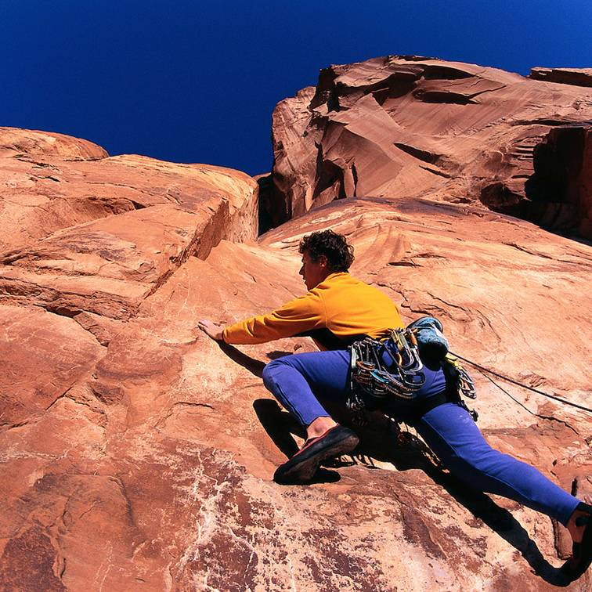
How can you better press on in your own journey of faith?
This Photo by Unknown Author is licensed under CC BY-NC-ND
Notes:
Exhortation: Are you also “in the wilderness”? How can you better press on in your own journey of faith?
If you feel like your fellowship with God is hindered now, do you need to “clean the pipe”? What must you confess?
Do things seem dark now? Do not fail to trust God in the darkness for what he has revealed in the light.

Slide 45
Black

Slide 46


Topical Preaching link at BibleStudyDownloads.org
Get this presentation and script for free!
Notes:
TP Topical Preaching

